Slide 1

Safe Lab Procedures and Tool Use
Computer Repair and Maintenance
Notes:
Cisco Networking Academy program
IT Essentials: PC Hardware and Software v4.0
Chapter 2: Safe Lab Procedures and Tool Use

Slide 2
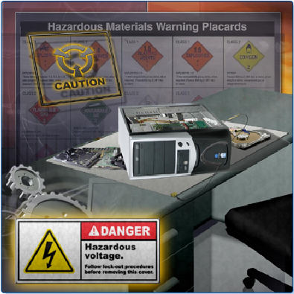
Objectives
2.1 Explain the purpose of safe working conditions and procedures
2.2 Identify tools and software used with personal computer components and their purposes
2.3 Implement proper tool use
Notes:
The purpose of this chapter is to protect users from accident and injury, equipment from damage, and the environment from contamination. Upon completion of this Chapter, students will be able to perform tasks related to:
2.1 Explain the purpose of safe working conditions and procedures
2.2 Identify tools and software used with personal computer components and their purposes
2.3 Implement proper tool use

Slide 3
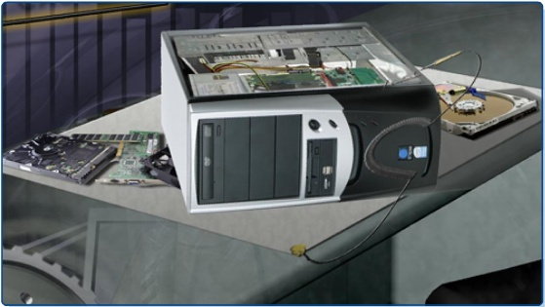
Worksheets and Labs
2.3.4 Lab: Computer Disassembly

Slide 4


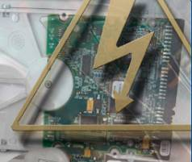

Safe Lab Procedures and Tool Use
The workplace should have safety guidelines to follow to:
Protect people from injury
Protect equipment from damage
Protect the environment from contamination

Slide 5
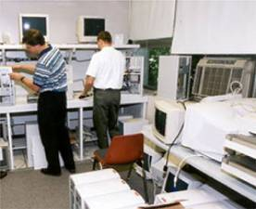
Recognize Safe Working Conditions
Some things to look for:
Clean, organized, and properly lit workspace
Proper procedures for handling equipment
Proper disposal or
recycling of components
containing hazardous
materials

Slide 6

General Safety Guidelines
Most companies require
reporting any injuries, including
description of safety procedures
not followed.
Damage to equipment may
result in claims for damages
from the customer.
CAUTION: Power supplies and monitors contain very high voltage.
CAUTION: Some printer parts may become very hot when in use and other parts may contain very high voltages.

Slide 7
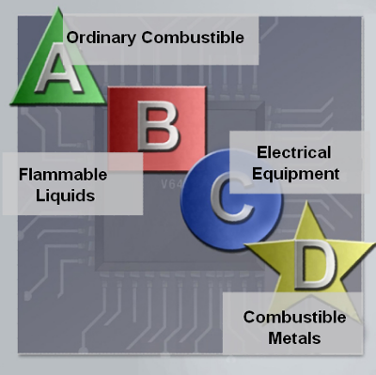
Fire Safety Guidelines
Have a fire plan before you begin work:
Know the location of fire extinguishers, how to use them, and which to use for electrical fires and for combustible fires
Have an escape route in case a fire gets out of control
Know how to contact emergency services quickly
Keep the workspace clean
Keep most solvents in a separate area
Notes:
Slide 8 – Fire Safety Guidelines
Solvents are substances, mostly in the form of liquid,
Fire Safety Guidelines - Follow fire safety guidelines to protect lives, structures, and equipment. To avoid an electrical shock, and to prevent damage to the computer, turn off and unplug the computer before beginning a repair.
Have a fire plan before you begin work:
Know the location of fire extinguishers, how to use them, and which to use for electrical fires and for combustible fires
Have an escape route in case a fire gets out of control
Know how to contact emergency services quickly
Keep the workspace clean
Keep most solvents in a separate area
In the United States, there are four classifications for fire extinguishers. A different letter, color, and shape identifies each fire extinguisher classification. Each type of fire extinguisher has specific chemicals to fight different types of fires:
Class A – Paper, wood, plastics, cardboard
Class B – Gasoline, kerosene, organic solvents
Class C – Electrical equipment
Class D – Combustible metals
What types of fire extinguisher classifications are there in your country?
It is important to know how to use a fire extinguisher. Use the memory aid P-A-S-S to help you remember the basic rules of fire extinguisher operation:
P - Pull the pin.
A - Aim at the base of the fire, not at the flames.
S - Squeeze the lever.
S - Sweep the nozzle from side to side.
Teaching Strategy: In the US, contacting emergency services will often consist of calling 911. If the technician always carries a working cell phone on his/her person, the contact can be made very quickly, immediately after leaving the fire.
Some types of fire extinguishers will spread fires of the wrong type. Some will be ineffective on other types of fires. More than one type of extinguisher will be needed in most repair facilities.
You might challenge your students to locate and identify the nearest fire extinguishers in your lab.

Slide 8

Power Fluctuation
AC power fluctuations can cause data loss or hardware failure:
Blackouts, brownouts, noise, spikes, power surges
To help shield against power fluctuation issues, use power protection devices to protect the data and computer equipment:
Surge suppressors
UPS
SPS
.
Notes:
Slide 10 – Power Fluctuation==an irregular rising and falling in number or amount; a variation
A power surge is basically a spike in your home's electrical current
Voltage is the force that moves electrons through a circuit. The movement of electrons is called current. Computer circuits need voltage and current to operate electronic components. When the voltage in a computer is not accurate or steady, computer components may not operate correctly. Unsteady voltages are called power fluctuations.
The following types of AC power fluctuations can cause data loss or hardware failure:
Blackout - Complete loss of AC power
Brownout - Reduced voltage level of AC power that lasts for a period of time
Noise - Electrical interference from generators and lightning
Spike - Sudden increase in voltage that lasts for a very short period and exceeds 100% of the normal voltage on a line
Power surge - Dramatic increase in voltage above the normal flow of electrical current
To help shield against power fluctuation issues, use power protection devices to protect the data and computer equipment:
A surge suppressor helps protect against damage from surges and spikes. A surge suppressor diverts extra electrical voltage on the line to the ground.
Uninterruptible Power Supply (UPS) helps protect against potential electrical power problems by supplying electrical power to a computer or other device.
Standby Power Supply (SPS) helps protect against potential electrical power problems by providing a backup battery to supply power when the incoming voltage drops below the normal level.
CAUTION: Never plug a printer into a UPS device. UPS manufacturers suggest not plugging a printer into a UPS for fear of burning up the printer motor.
Teaching Strategy: Dangers to computer equipment and data include; spike, power-in rush, brownout, blackout, lightning, jewelry, spills, and drops. Climate impacts probability of ESD. Devices that can protect the equipment from electrical damage include; Surge protector, UPS, antistatic mats and bags, antistatic wrist straps.

Slide 9

Proper Disposal
Batteries from portable computer systems may contain lead, cadmium, lithium, alkaline manganese, and mercury. Recycling batteries should be a standard practice for a technician.
Monitors contain up to 4 pounds of lead, as well as rare earth metals. Monitors must be disposed of in compliance with environmental regulations.
Used printer toner kits and printer cartridges must be disposed off properly or recycled.
Contact the local sanitation company to learn how and where to dispose of the chemicals and solvents used to clean computers.
Notes:
Slide 12 – Proper Disposal
Recycling is the process of converting waste materials into new materials and objects
the action or process of throwing away or getting rid of something
Protecting the environment by responsibly disposing and recycling
Batteries from portable computer systems may contain lead, cadmium, lithium, alkaline manganese, and mercury. Recycling batteries should be a standard practice for a technician.
Monitors contain up to 4 pounds of lead, as well as rare earth metals. Monitors must be disposed of in compliance with environmental regulations.
Used printer toner kits and printer cartridges must be disposed of properly or recycled.
Contact the local sanitation company to learn how and where to dispose of the chemicals and solvents used to clean computers.
Teaching Strategy: Computers and peripherals contain some environmentally unfriendly materials. Most computer components are either hazardous or contain some level of hazardous substances. Describe the proper disposal/recycling of hazardous materials (batteries, electronic devices, and chemical solvents)

Slide 10
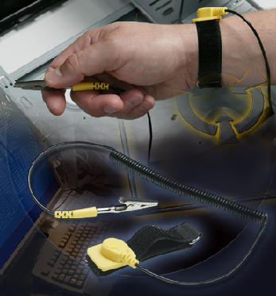
Proper Use of Antistatic Wrist Strap
Antistatic wrist strap, or ground bracelet is an antistatic device used to safely ground a person working on very sensitive electronic equipment, to prevent the buildup of static electricity on their body, which can result in ESD
Connect the cable to the metal chassis of the computer
Wrap the strap around your wrist
The connection will keep your body at the same voltage (potential) as the computer
Attach the wire on the same side
of the equipment as the arm
wearing the antistatic wrist strap
to keep the wire out of the way
while you are working.
Notes:
Safety in the workplace is everyone's responsibility. You are much less likely to injure yourself or damage components when using the proper tool for the job.
Before cleaning or repairing equipment, check to make sure that your tools are in good condition. Clean, repair, or replace any items that are not functioning adequately.
Teaching Strategy: Proper use of tools is mandatory to be an effective, professional technician. You can hurt yourself and others if you do not follow safety procedures when using tools. You can also damage equipment if tools are not used properly. Keep equipment and tools clean; dirt reduces their operation and efficiency.
At the end of this section, students will meet these objectives:
Demonstrate Proper Use of Wrist Strap
Demonstrate Proper Use of Antistatic mat
Demonstrate Proper Use of Various Hand Tools
Demonstrate Proper Use of Cleaning Materials
2.3.1 Demonstrate proper use of an antistatic wrist strap
Properly using an antistatic wrist strap can prevent ESD damage to computer components. The wrist strap is a conductor that connects your body to the equipment you are working on. The main purpose for using a wrist strap is to equalize the electrical charge between the technician and the equipment. The connection to the person's wrist may not be complete (zero ohms), but even a fairly high resistance connection is sufficient to keep the person and the chassis at the same potential.
The strap has two parts and is easy to wear:
Wrap the strap around your wrist and secure it using the snap or Velcro. The metal on the back of the wrist strap must remain in contact with the skin at all times.
Snap the connector on the end of the wire to the wrist strap and connect the other end either to the equipment or to the same grounding point that the antistatic mat is connected to. The metal skeleton of the case is a good place to connect the wire. When connecting the wire to equipment you are working on, choose an unpainted metal surface. A painted surface does not conduct the electricity as well as unpainted metal.
NOTE: Attach the wire on the same side of the equipment as the arm wearing the antistatic wrist strap. This will help to keep the wire out of the way while you are working.
Although wearing a wrist strap will help to prevent ESD, you can further reduce the risks by not wearing clothing made of silk, polyester, or wool. These fabrics are more likely to generate a static charge.
NOTE: Technicians should roll up their sleeves, remove scarves or ties, and tuck in their shirts to prevent interference from clothing. Ensure that earrings, necklaces, and other loose jewelry are properly secured.
Caution: A wrist strap does not protect you against high voltages. Do not use it to repair monitors or power supplies. Only qualified personnel should open monitors or power supplies.
Electrostatic discharge (ESD) is the sudden flow of electricity between two electrically charged objects caused by contact, an electrical short, or dielectric breakdown.

Slide 11
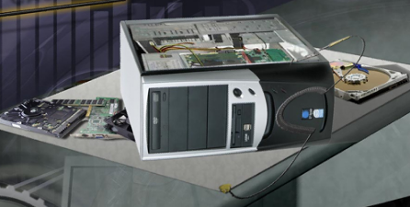
Proper Use of Antistatic Mat
Lay the computer on the mat.
Connect the computer to the mat with the cable.
Connect the mat to a reliable electrical ground with its cable.
Now, you and the computer are at ground potential.
Notes:
2.3.2 Demonstrate proper use of an antistatic mat
An antistatic mat is slightly conductive and works by drawing static electricity away from a component, and transferring it safely from equipment to a grounding point.
Lay the mat on the workspace next to or under the computer case.
Clip the mat to the case to provide a grounded surface on which you can place parts as you remove them from the system.
Reducing the potential for ESD reduces the likelihood of damage to delicate circuits or components.
NOTE: Always handle components by the edges.
When you are working at a workbench, ground the workbench and the antistatic floor mat. By standing on the mat and wearing the wrist strap, your body has the same charge as the equipment and reduces the probability of ESD.
Teaching Strategy: Anti-static mats are electrical conductors. The anti-static mat on the computer bench and the anti-static you stand on are both grounded.
Key Points: Ground antistatic mat.

Slide 12


Proper Use of Hand Tools
Use the proper type and size of screwdriver by matching it to the screw.
  Phillips, Flat Head and Hex are the most common types.
Do not over tighten screws because the threads may become stripped.
Caution: If excessive force is needed to remove or add a component, something is likely to be wrong.
Caution: Pencils should not be used inside the computer because the pencil lead can act as a conductor and may damage the computer components.
Notes:
Slide 18 – Proper Use of Hand Tools
2.3.3 Demonstrate proper use of various hand tools
Use the proper type and size of screwdriver by matching it to the screw.
Phillips, Flat Head and Hex are the most common types.
Do not over tighten screws because the threads may become stripped.
Caution: If excessive force is needed to remove or add a component, something is likely to be wrong. Do not force the removal or assembly of any components. Instead, look for the cause to avoid breaking components.
Caution: Magnetized tools should not be used around electronic devices.
Caution: Pencils should not be used inside the computer because the pencil lead can act as a conductor and may damage the computer components.
Teaching Strategy: Using any tool improperly can be dangerous. Use the correct tool for the right job. For example, do not use needle-nose pliers to remove screws. Be careful not to cut wires. Do not use a flat head screwdriver to install or remove Phillips screws. Do not use screw drivers as a prying tool. Anything that has to be forced is a problem! Needle nose pliers and tweezers can retrieve small parts. Be careful not to scratch the small copper circuit board traces. Do not use a pencil as a tool inside a computer. Pencil lead is conductive, and traces of it may alter the operation of circuits. No magnetic tips with screwdrivers. Instead, stab a screw through a piece of masking tape to hold it in place.
If you have an old motherboard, you could show students how small the circuit traces are.

Slide 13
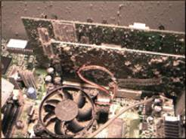
Proper Use of Cleaning Materials
To clean computers and accessories:
Use mild cleaning solution and lint-free cloth to clean computer cases, outside of monitor, LCD screen, CRT screen, and mouse.
Use compressed air to clean heat sinks.
Use Isopropyl alcohol and lint-free swabs to clean RAM.
Use hand-held vacuum cleaner
with a brush attachment to clean
a keyboard.
CAUTION: Before cleaning any
device, turn it off and unplug the
device from the power source.
Notes:
Slide 19 – Proper Use of Cleaning Materials
2.3.4 Demonstrate proper use of cleaning materials
Keeping computers clean inside and out is a vital part of a maintenance program. Dirt can cause problems with the physical operation of fans, buttons, and other mechanical components.
CAUTION: Before cleaning any device, turn it off and unplug the device from the power source.
Teaching Strategy: Computer components get dirty. Dirt reduces their operations and efficiency due to heat build up.
Components that need to be cleaned periodically include monitor/LCD, exterior of the computer, optical drive, floppy drive, keyboard, printers and the inside of the case or chassis.
When cleaning, shut down and turn off the device to be cleaned. Disconnect any attached devices and disconnect them from their electrical outlets.
Electronic components should never be near water. Use isopropyl alcohol to clean contacts. However, de-mineralized water can be used on a cloth to clean keyboards. Only use products specifically designed for cleaning computer components.
Use a can of compressed air to remove dust from the slots and holes on your laptop and between the keys on the keyboard. Use compressed air rather than vacuum. Vacuuming can produce ESD.
To clean the outside of the computer and video display, moisten a soft, lint-free cloth with the proper cleaning solution, and wipe the component until it is clean. To avoid damaging the computer or display, never spray cleaning solution directly onto the display.
Moisten a soft, lint-free cloth with water or an LCD cleaner, and wipe the display until it is clean. To avoid damaging the computer or display, do not spray cleaning solution directly onto the display. Only use products specifically designed for cleaning LCD displays.
Student Activity: The student course content includes the lab activity, 2.3.4 Lab: Computer Disassembly. To complete this lab activity, students will disassemble a computer using safe lab procedures and proper tools.

Slide 14
Chapter Summary
Safe Lab Procedures and Tool Use
Follow safety procedures for personal protection, equipment protection, and environmental protection.
Know what tools and software to use in working with computers and computer components.
Follow proper use of tools.
  Anti-static wrist strap, anti-static mat, various hand tools, and cleaning materials
Notes:
Some of the important concepts to remember from this module:
Work in a safe manner to protect both users and equipment.
Follow all safety guidelines to prevent injuries to yourself and to others.
Know how to protect equipment from ESD damage.
Know about and be able to prevent power issues that can cause equipment damage or data loss.
Know which products and supplies require special disposal procedures.
Familiarize yourself with MSDS sheets for both safety issues and disposal restrictions to help protect the environment.
Be able to use the correct tools for the task.
Know how to clean components safely.
Use organizational tools during computer repairs.

Slide 15
Additional Resources
U.S. Dept of Labor, Occupational Safety & Health Administration http://www.osha.gov
Microsoft Technet website http://www.technet.microsoft.com
The PC Guide http://www.pcguide.com
Computer Hope.com: Free computer help for everyone. http://www.computerhope.com
Tech Support Forum http://www.techsupportforum.com/
PC Technology Guide: What We Learn, We Share http://www.pctechguide.com
PC TechBytes: Computers Made Easy, Computer Repair Support http://www.pctechbytes.com
TechWatch: Your Source For Technology, News, Reviews and Pricing http://www.techwatch.com.au
TechRepublic: A Resource for IT Professionals http://www.techrepublic.com
The Tech Zone.com http://www.thetechzone.com
Notes:
U.S. Dept of Labor, Occupational Safety & Health Administration http://www.osha.gov
Microsoft Technet website http://www.technet.microsoft.com
The PC Guide http://www.pcguide.com
Computer Hope.com: Free computer help for everyone. http://www.computerhope.com
Tech Support Forum http://www.techsupportforum.com/
PC Technology Guide: What We Learn, We Share http://www.pctechguide.com
PC TechBytes: Computers Made Easy, Computer Repair Support http://www.pctechbytes.com
TechWatch: Your Source For Technology, News, Reviews and Pricing http://www.techwatch.com.au
TechRepublic: A Resource for IT Professionals http://www.techrepublic.com
The Tech Zone.com http://www.thetechzone.com
Whatis?com: IT Encyclopedia and Learning Center http://whatis.com
TechTarget: The Most Targeted IT Media http://techtarget.com
ZDNet: Tech News, Blogs and White Papers for IT Professionals http://www.zdnet.com
HowStuffWorks: It's Good to Know http://computer.howstuffworks.com
CNET.com http://www.cnet.com
PC World http://www.pcworld.com
ComputerWorld http://www.computerworld.com
WIRED NEWS http://www.wired.com
eWEEK.com http://www.eweek.com

Slide 16


Q and A
Notes:
Slide 25 – Q and A

